Slide 1

Sentiment Analysis on Yelp
Group23
Zheng Binfan 3035588324 u3558832@connect.hku.hk
Xie Diangu 3035585803 u3558580@ connect.hku.hk
Gao Peixin 3035585114 u3558511@ connect.hku.hk

Slide 2
Job Distribution
Tasks |  | Group leader | Member | Member
 |  | Zheng | Gao | Xie
Data | Data collection | √ | √ | √
 | Data pre-processing | √ | √ | √
 | Database organization | √ | √ | √
Spark Clustera | Deploy the project to Spark cluster and accomplish the training process | √ | √ | √
 | Cluster maintenance | √ | √ | √
 | Performance Evaluation | √ | √ | √
Algorithm | Deep learning algorithm
 | Revise the algorithm to suit cluster computation | √ | √ | √
Others | Web UI Design |  | √
 | Prepare presentation PPT | √ | √ | √
 | Live demo | √ | √ | √
 | Demo video preparation | √ | √ | √
 | Write the final report | √ | √ | √
PART
Notes:
模板来自于 http://meihua.docer.com/

Slide 3
01
System Design & Processing Flow
02
Installation Success Test
03
Configuration Design & Key Features
CONTENTS
04
Application Execution(Test & Target Finish)
05
Discussion & Analysis & Novelty
06
Problem solving
07
Preference

Slide 4
01
PART
System Design & Data Processing
The layered view of the overall system configuration and the data processing.
Notes:
模板来自于 http://meihua.docer.com/

Slide 5
1.1. System Design
1.1.1 System Architecture[Some description from Wiki or Lecture of 7305]
Packages | Description
Xen 4.9 | Providing services that allow multiple computer operating systems to execute on the same computer hardware concurrently.
Ubuntu | Free and open-source Linux distribution based on Debian.
Hadoop-2.7.5 | A collection of open-source software utilities that facilitate using a network of many computers to solve problems involving massive amounts of data and computation.
Spark-2.4.0 | A unified analytics engine for large-scale data processing.
Spark-Mlib | A apache Spark's scalable machine learning library.

Slide 6
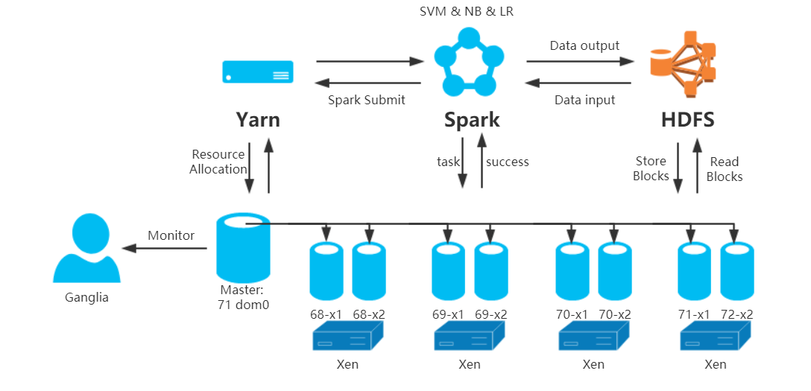
1.1. System Design
1.1.2 System Design Graph
Spark MLlib

Slide 7
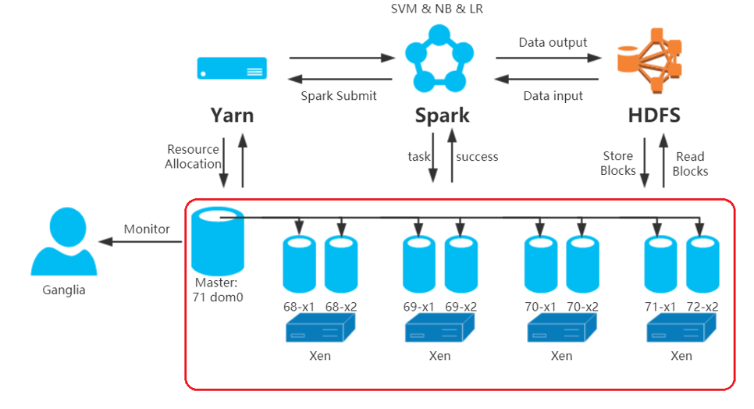
1.1. System Design
1.1.2 System Design Graph
Spark MLlib

Slide 8
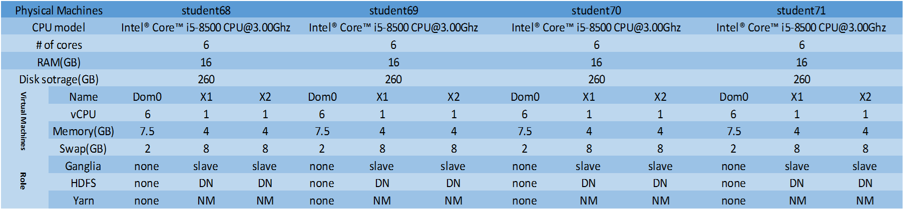
1.1. System Design
1.1.3 Cluster Configuration

Slide 9
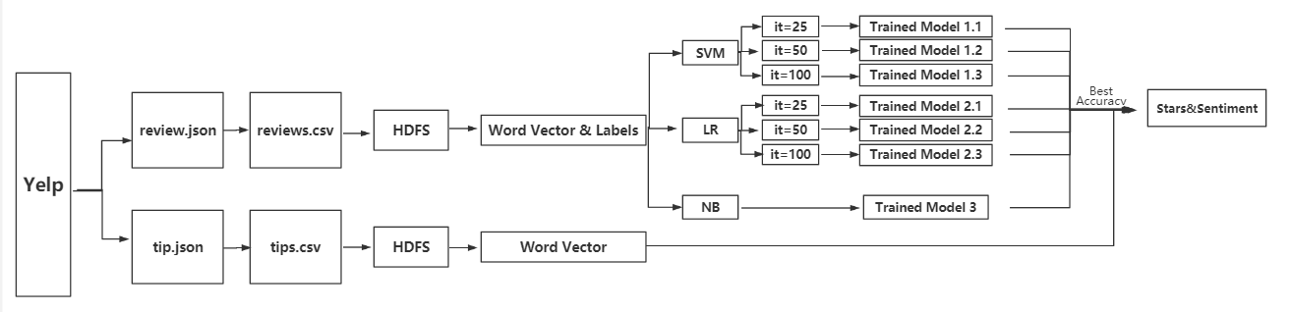
1.2. Processing Flow
1.2.1 The whole flow
1.Download the dataset Yelp from the official website: https://www.yelp.com/dataset/download.
2.Extract needed attributes in tip.json and review.json and change their form to csv, and save them into HDFS.
3.Change their data form to RDD in spark and use tf-idf to change text to word vectors.
4.Use three ML algorithms we are interested to train models based on reviews, and get the best model.
5.Predict tip’s texts’ star and sentiment.
[PS:A more specific version is displayed in 3.3]

Slide 10
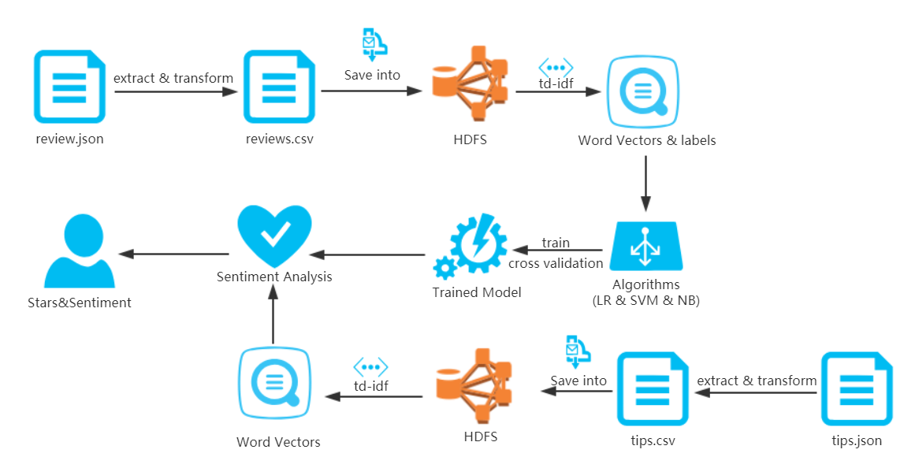
1.2. Processing Flow
1.2.2 Training and Predicting Data Processing Architecture

Slide 11
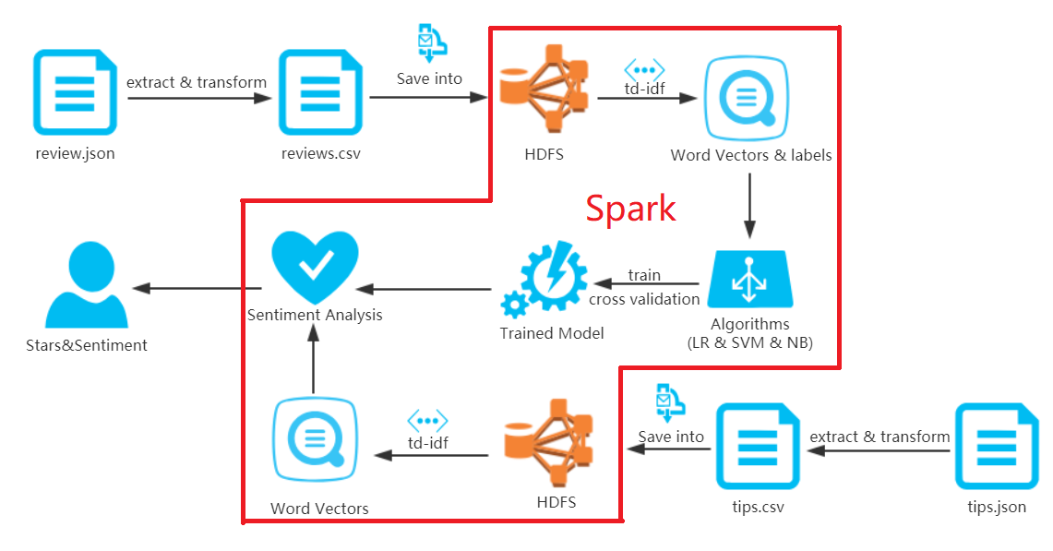
1.2. Processing Flow
1.2.2 Training and Predicting Data Processing Architecture

Slide 12
02
PART
Installation Test & Ganglia Monitor
Some shots to prove the success of software installation and the resource usage using ganglia after running the most computation intensive task.
Notes:
模板来自于 http://meihua.docer.com/

Slide 13
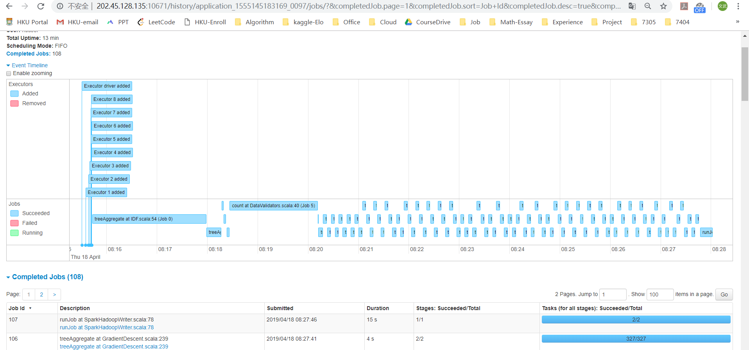
2.1. Installation Test
A timeline in spark of a test program of our own code.
We can find some separated tasks in this graph, and it cost 13min to get the result.

Slide 14
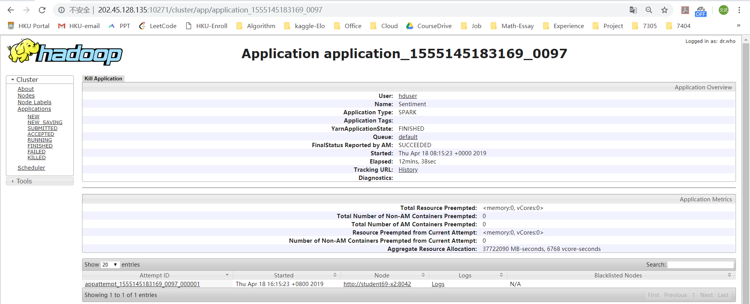
2.1. Installation Test
The information in Hadoop of a test program of our own code.
We can find some information in this Hadoop web interface.

Slide 15
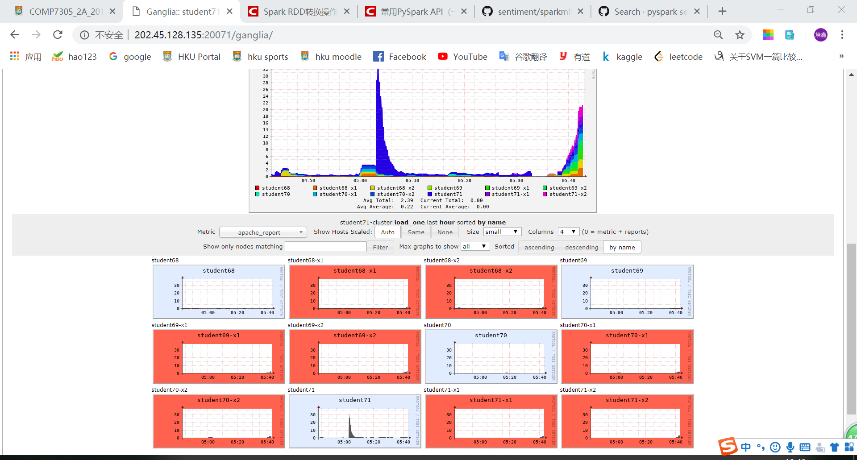
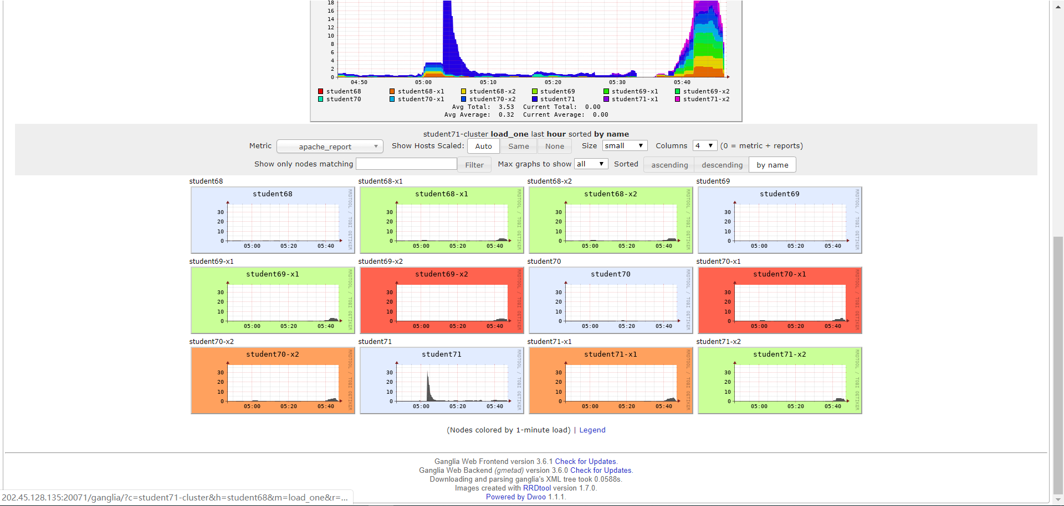
2.2. Ganglia Monitor
The ganglia monitor after we finished the most computation intensive task.
Begin End
At the beginning when we run the code, all screens about slaves are red.
After finished the whole process, machines become green gradually.

Slide 16
03
PART
Configuration Design & Key Features
1)Summary of the configurations of Hadoop and Spark; 2)Key features/functions/algorithm
Notes:
模板来自于 http://meihua.docer.com/

Slide 17
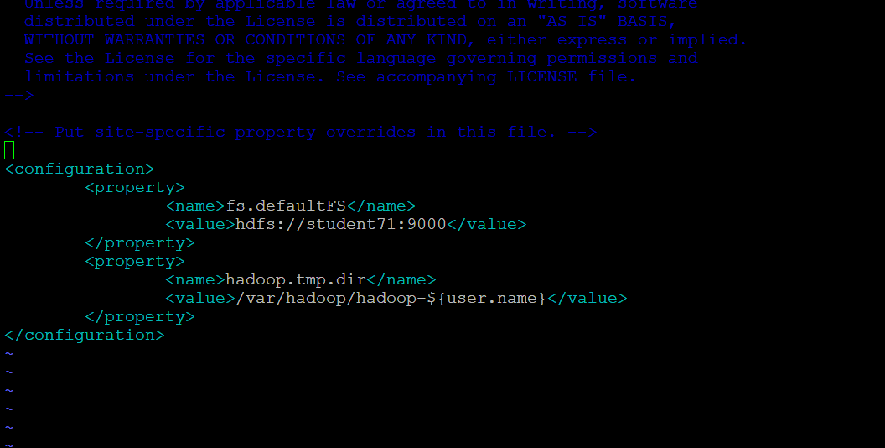
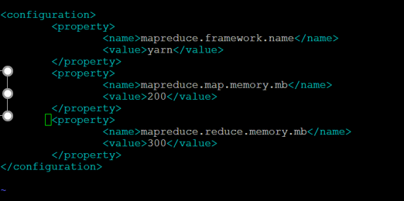
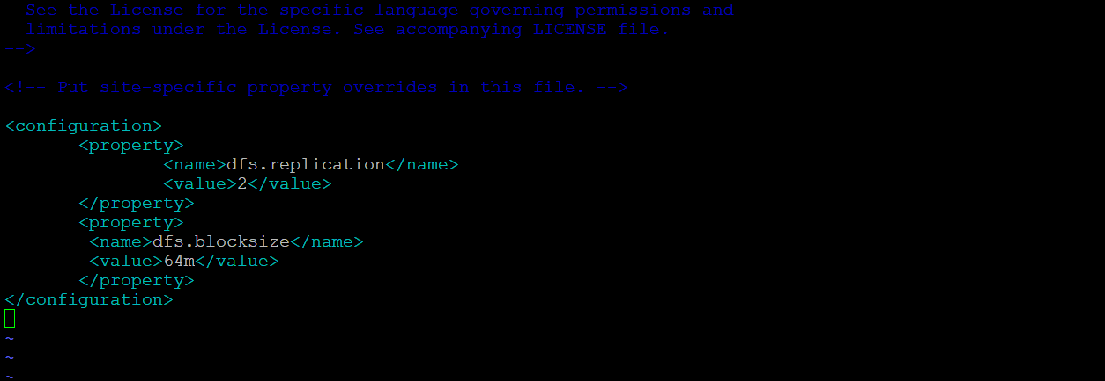
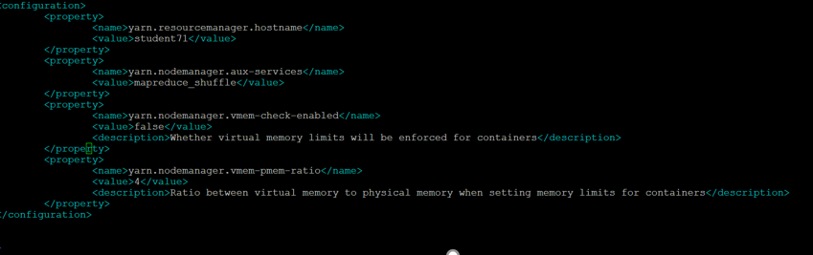
3.1. Configuration Design
3.1.1 The configuration files of Hadoop
mapred-site.xml
core-site.xml
hdfs-site.xml
yarn-site.xml

Slide 18
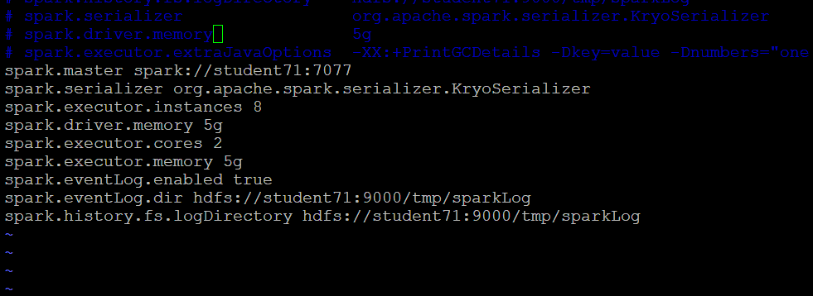
3.1. Configuration Design
3.1.2 The configuration files of spark
Since this algorithm need large memory, we change the driver memory and executor memory to 5G in configuration of Spark because of the memory error.
In order to use the resource efficiently, we change the number of executor to 10 in spark.[We do make a mistake here! Since we just assign each VM 4G memory, some memory are slopping over to disk, which slows our speed…]
spark-defaults.xml

Slide 19
3.2. Key features
3.2.1 Key features
Features | Description
text | The word text of a review, and it stored both in review.json and tip.json.
stars | In review.json, we have the stars of each text, so we can know this text is positive or negative. The star’s range is [1,2,3,4,5]
Use text and star in tip.json to train the model and get the accuracy of each model.
Use the best model to predict the star or sentiment of tip.json.

Slide 20
3.2. Key features
3.2.2 Key functions
Functions | Description
json-csv.py json2bigcsv.py | Change tip.json(review.json) file to csv file so Spark can read it directly.
Sentiment.py | 1.Read csv file and change it to RDD form. 2.Transform text to word-vectors by tf-idf. 3.Train the model and make the prediction.
In json-csv.py and json2bigcsv.py, use library “json” and “csv” to write json and store data set as csv form.
In sentiment.py, use library “pyspark”’s “pyspark.mllib” & “pyspark.ml” and “jieba”.
2.1.Use library functions SparkConf, SparkContext, textFile to read csv files and change its form to RDD.
2.2.Use function HashingTF to get the word vectors of text.
2.3.Use NaïveBayes, SVMWithSGD and LogisticRegression to train the model and get prediction.

Slide 21
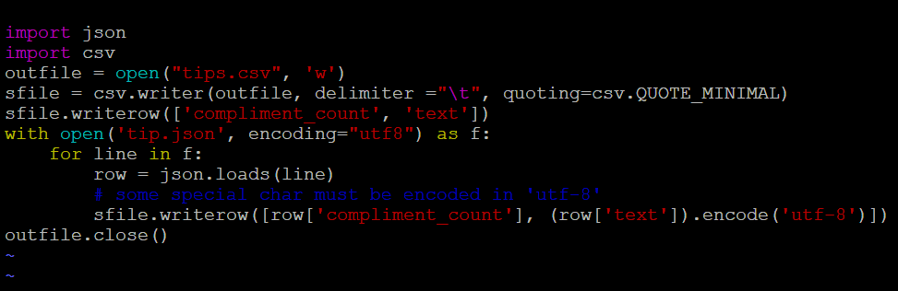
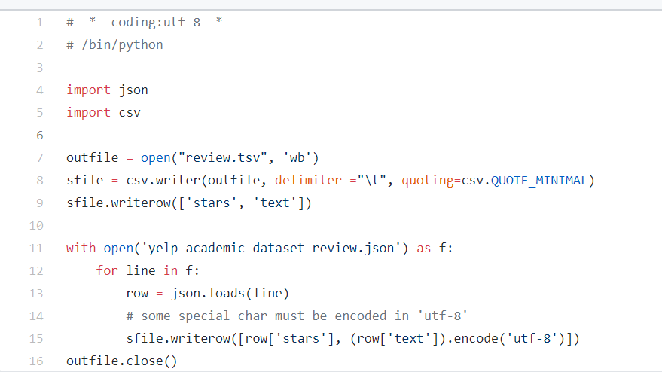
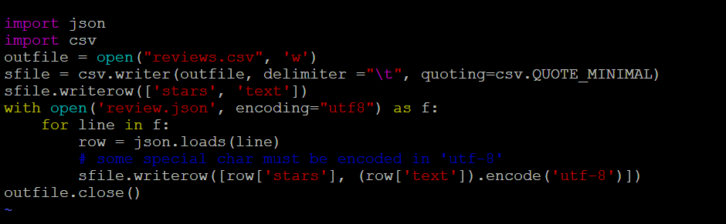
3.2. Key features
3.2.2 Key functions[Showing Part1:json-csv.py & json2bigcsv.py]
Original code
Our code
https://github.com/zhourunlai/sentiment/blob/master/classifier/sparkmllib.py

Slide 22
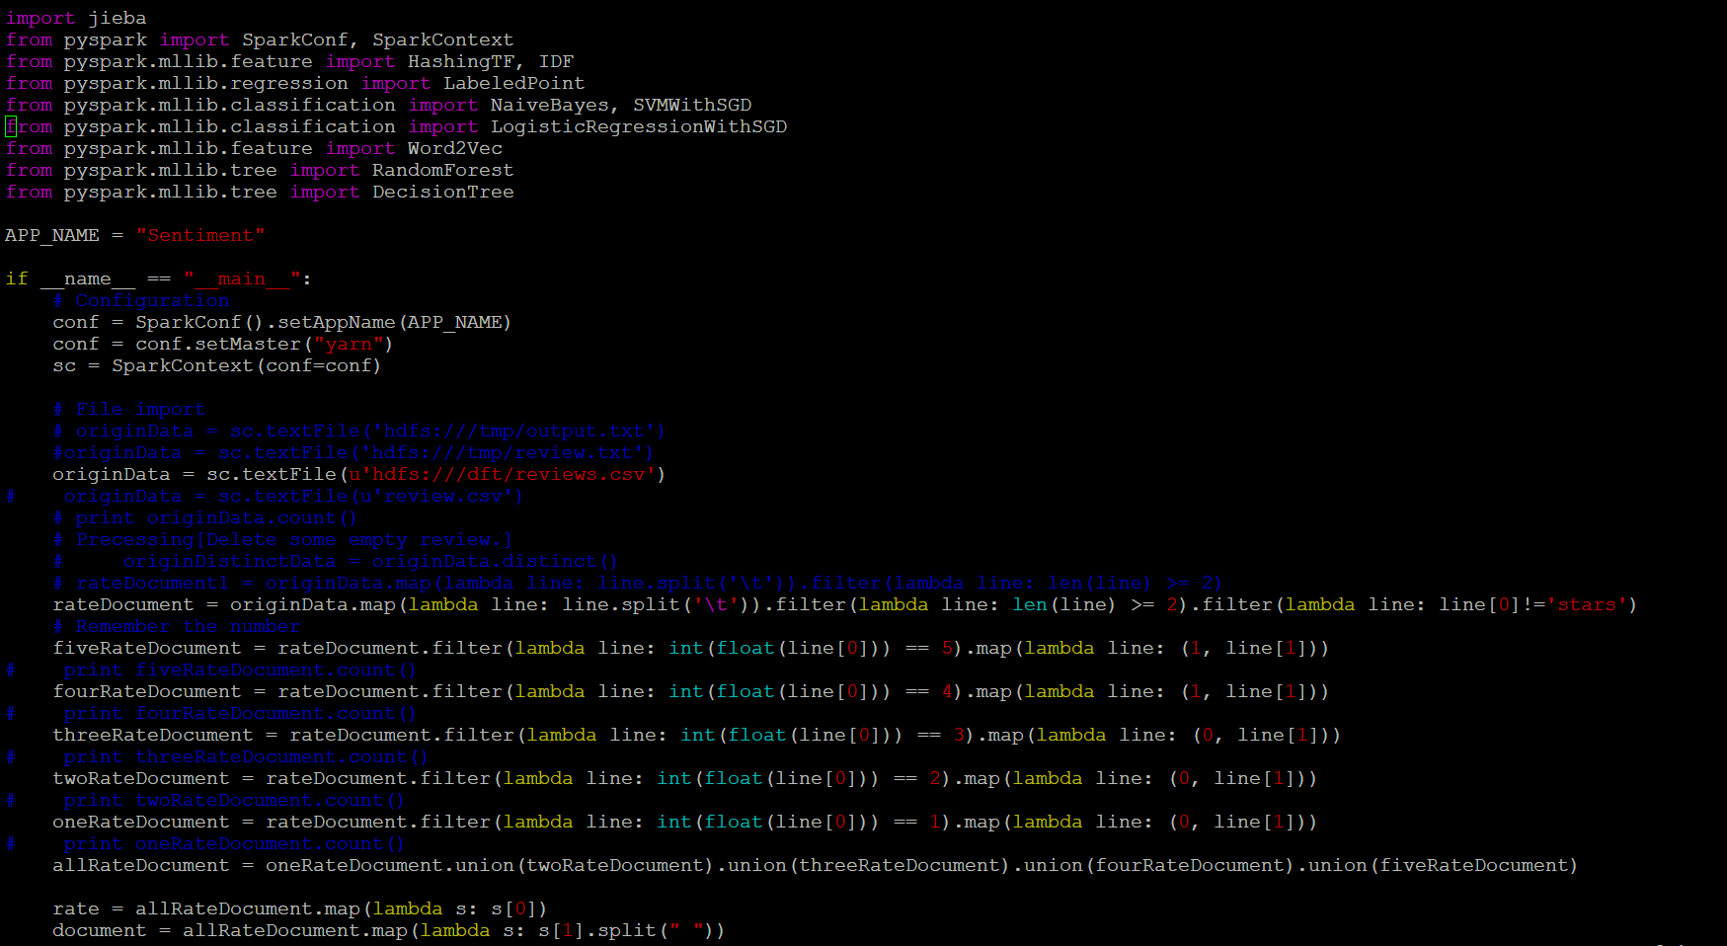
3.2. Key features
3.2.2 Key functions[Showing Part2:sentiment_test3.py]
What we changed

Slide 23
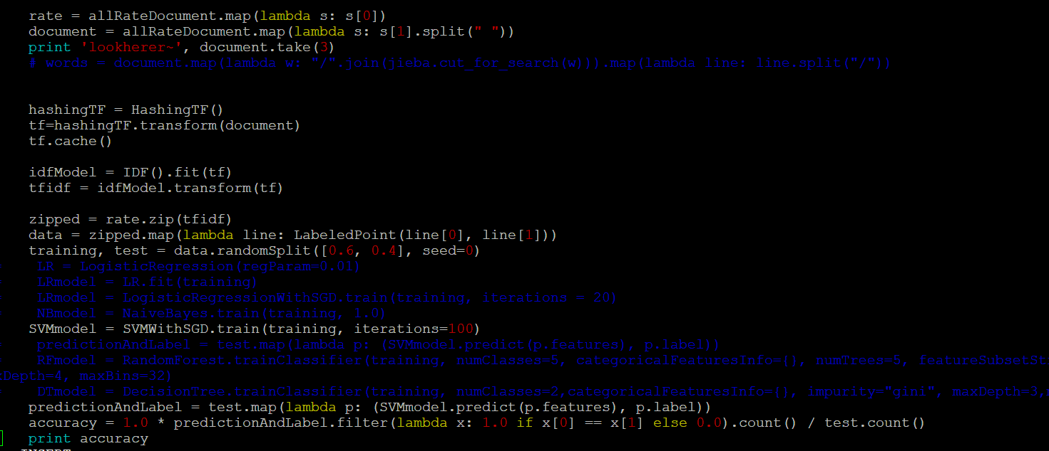
3.2. Key features
3.2.2 Key functions[Showing Part2:sentiment_test3.py]
What we changed

Slide 24
3.2. Key features
3.2.3 Key Algorithms [Description from Wiki].
Algorithm | Description
SVM | Supervised learning models with associated learning algorithms that analyze data used for classification and regression analysis..
Logistical Regression | A widely used statistical model. In its basic form it uses a logistic function to model a binary dependent variable,
Naïve Bayes | A family of simple "probabilistic classifiers" based on applying Bayes' theorem with strong (naive) independence assumptions between the features.
We use three different ML algorithms and make some adjustment of their parameters to find the best trained model.
According to the accuracy of results, we can find SVM with iteration 100 times is the best model whose accuracy is 89.78%[The comparison is displayed in the 5.2.1].

Slide 25
04
PART
Application Execution(Test & Target Finish)
Different execution time of our application for different sizes of input data sets.
Some information about the largest data test case.
Notes:
模板来自于 http://meihua.docer.com/

Slide 26
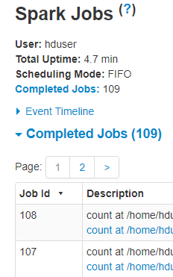
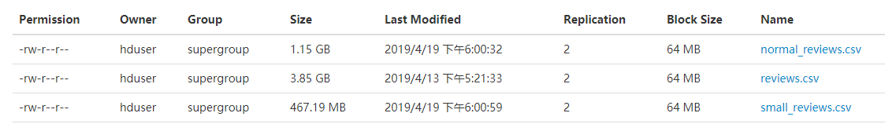
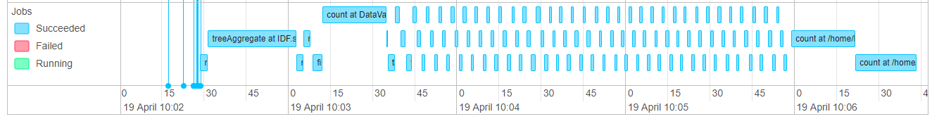
4.1. Different data sets’ test
4.1.1:467.19M
Input Data size: 467.19MB
Execution time: 4 min and 42 sec
About 35 seconds
About 2 minutes and 30 seconds

Slide 27
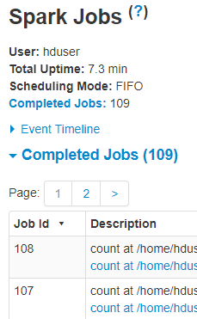
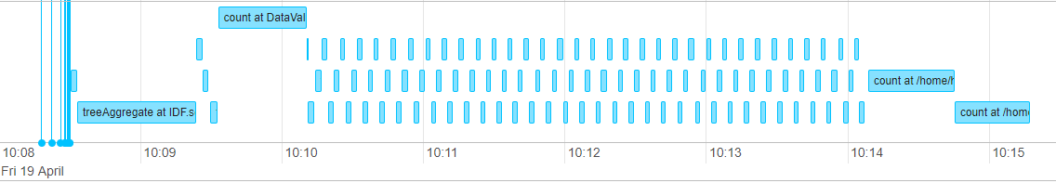
4.1. Different data sets’ test
4.1.2: 1.15G
Input Data size: 1.15GB
Execution time: 7 min and 18 sec
About 50 seconds
About 4 minutes

Slide 28
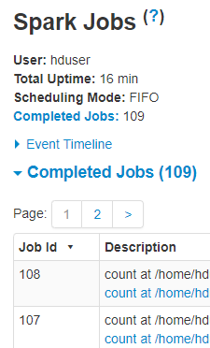
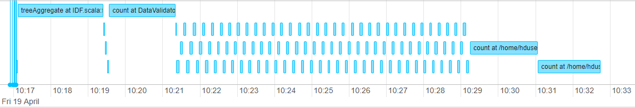
4.1. Different data sets’ test
4.1.3: 3.9G[The largest data set]
Input Data size: 3.85GB(The whole dataset)
Execution time: 16 min
About 2 minutes 30 seconds
About 8 minutes

Slide 29
4.1. Different data sets’ test
4.1.4: Summary
Data Size | TF-IDF | Train
467.19MB | 35s | 150s
1.15GB | 50s | 240s
3.85GB | 150s | 480s

Slide 30
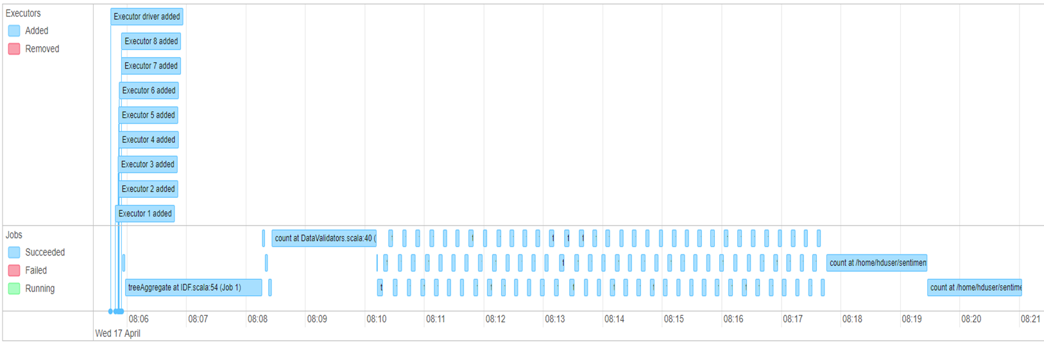
4.2. The largest data test case
Word vector
2 min and 18 sec
Longest execution time!
100 Iterations
5s for each iteration
Predicting
1 min and 42 sec
Split Dataset
1 min and 48 sec
Computing accuracy
1 min and 36 sec

Slide 31
05
PART
Discussion & Analysis & Novelty
1.The key findings here.
2.Results Analysis(Comparison & Result Visualization).
3.Noverlty.
Notes:
模板来自于 http://meihua.docer.com/

Slide 32
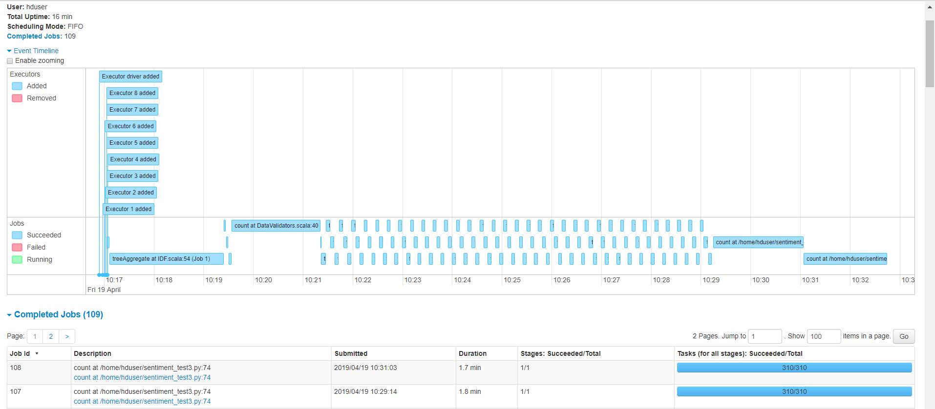
5.1. The key finding here
Q&A Part1
1.Is the response time (from query submission till result shown) acceptable?
Actually, I think it is acceptable. The biggest data set(the whole data set of yelp) cost around 15~16min. Among them, the train process is long but quick actually(7min50s/3.6 millions reviews around 2.4GB); the predict is so fast(3.5min/2.4 millions reviews around1.5GB).

Slide 33
5.1. The key finding here
Q&A Part2
2.Which part of your system is the bottleneck?
As for the whole processing flow, I think the train part is still a little slowly, since we can find it may cost around 8 minutes to train this model while the iteration is 100. We ignore too many iterations to avoid the overfitted problems and the accuracy we get is from the outside the sample which is divided from the original dataset(40 percent).
As for some configurations, this problem will also be discussed in next question 3&4.
3. How did you improve the execution speed?
3.1 Increase the number of execution from 2 to 8 to 10(10 looks no speeding).[See the next slider]
3.2 [Failed Operation]Increase the executor’s cores. [It still have just 9 cores are run after changing.]

Slide 34
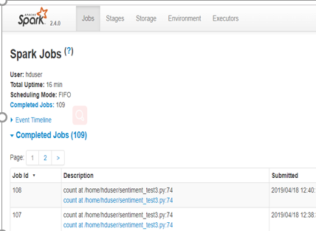
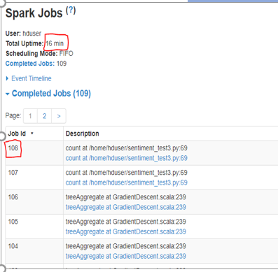
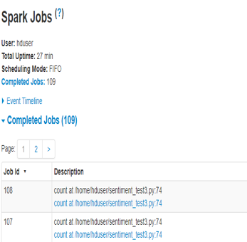
5.1. The key finding here
8 executors
Execution time: 16 min
Stage: 109 jobs
The attachment for answer 3.1
10 executors
Execution time: 16 min
Stage: 109 jobs
Same result with 10 executors!
5 executors
Execution time: 27 min
Stage: 109 jobs

Slide 35
5.1. The key finding here
Q&A Part3
4. Did you reconfigure the software system (Xen/Hadoop/Spark), rewrite
some of the Spark code, or redesign the algorithms
4.1 We change some spark code, and add a LR algorithm & do some parameter optimization. [As showed in 3.2.2 key functions]
4.2 Change the executor memory and driver memory to 5G.[As showed in 3.1 Configuration Design.]

Slide 36
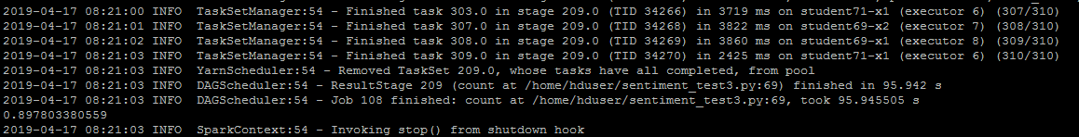
5.2. Result Analysis
5.2.1 Comparison
Algorithm | Accuracy | Execution Time
SVM (100 iterations) | 0.897803 | 16min
SVM (50 iterations) | 0.891528 | 12min
SVM (20 iterations) | 0.878525 | 9min and 48sec
Logistical Regression (100 iterations) | 0.889385 | 17min
Logistical Regression (50 iterations) | 0.883875 | 12min
Logistical Regression (20 iterations) | 0.872767 | 10min
Naïve Bayes | 0.859039 | 8min and 18sec
Best result: SVM (100 iterations)

Slide 37

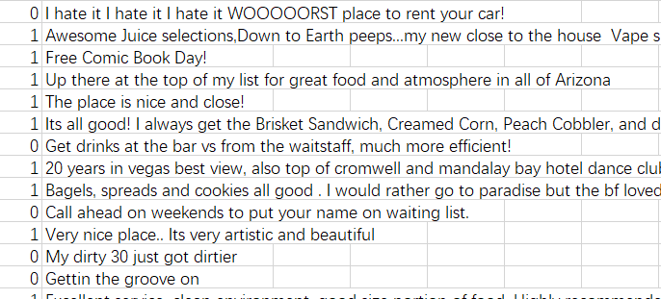
5.2. Result Analysis
5.2.2 Result Visualization
Now it’s time to input a new data file[tips.json as showed in our processing] which has text content and we can predict it to get some result![This code is also finished in spark in the sentiment.py]
【It is stored in the tips.csv. 】
Some Results
This result is according with our own views~ O(∩_∩)O
Word Cloud For Positive Response

Slide 38
5.2. Novelty
5.2.2 Result Visualization
1.who are the target users?
Firstly, the target users may be merchants in Yelp(of course) or the owner of Yelp who can get more scores for a store from reviews even with no scores. Secondly, any other regions caring about sentiment analysis can use this model to get more information based on text.
2.Why they like to use your applications?
Our goal is to build a sentiment analysis model that predicts whether a user liked a local business or not, based on their reviews on Yelp.Restaurant owners can use this model to interpret thousands of tweets, Facebook posts, blog posts or articles posts online, so they can understand the attitude of customers to them.

Slide 39
06
PART
Problem Solving
Some problems we encountered and how we solve it
Notes:
模板来自于 http://meihua.docer.com/

Slide 40
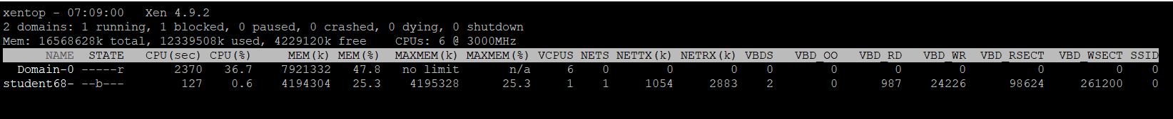
6.1.Schrodinger’s 68-x2
Occur and disappear, it’s a problem
Time: 6 April
Problem Introduction: At that day, I entered my own machine 68-x2 and wanted to continue my work, while I find I cannot enter 68-x2. Then I do some tests and restarted 68, stop and restart Hadoop under the help from our TA Miss.Wu(So thanks!), then I find some strange thing by “sudo xentop”:
The result of “xentop” changed around every ten seconds. Sometimes 68-x2 occurred while the state is paused or blocked, while sometimes its disappeared and I can just saw 68-x1. Additionally, I cannot connect 68-x2.
Around five hours’ struggle in some advice from google, I accepted the suggestion from TA that I should destroy and rebuilt x2. Then I solved some subproblems when rebuilt VM 68-x2.

Slide 41
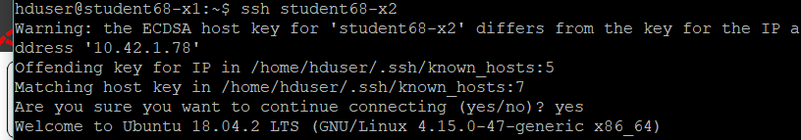
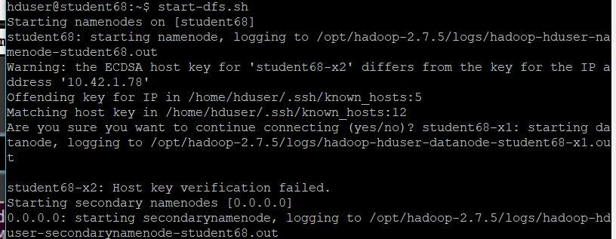
6.1.1 Subproblem1
The know_hosts conflicts in 68-x2.
Time: 10 April
Problem Introduction: Cannot enter 68-x2 without password after finish steps of ‘ssh-keygen –t rsa –P “”’ and copy it to VMs. So Hadoop cannot restart normally:
Process: 1. Check the IP address(it’s right)
2. Check the nameserver(it’s right)
3. Delete all know_hosts in all VMs and master, then repeat the ‘ssh-keygen –t rsa -P’s steps. Then format and restart Hadoop. The problem is solved finally.
Analysis: The know_hosts generated before make a conflict with the newly know_hosts(although there are no errors occurred when you rebuilt it). So you cannot enter the target without password until you delete all know_hosts and redo it.

Slide 42
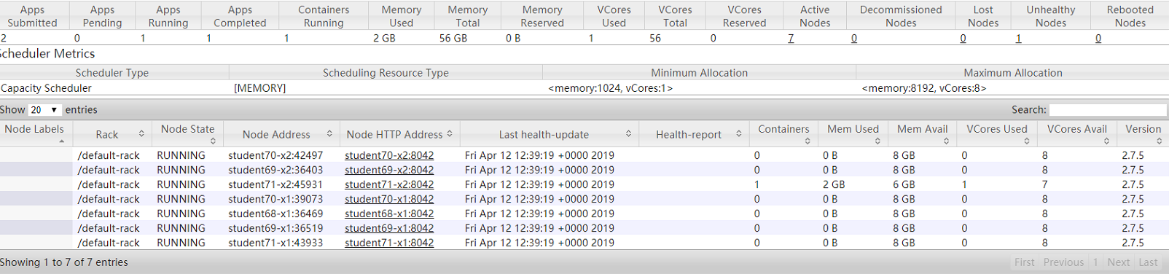
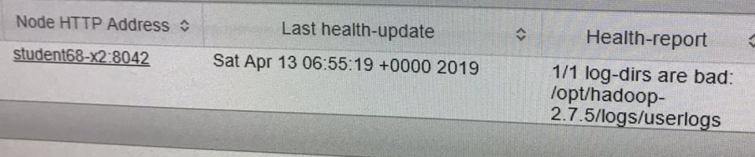
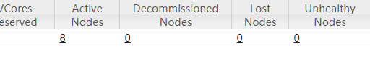
6.1.2 Unhealthy Nodes
Time: 11 April
Problem Introduction: We can run our code successfully, while we find the number of active nodes in the monitor is just 7, and there is an unhealthy node: the 68-x2!!! While in other parts(HDFS and monitored index), 68-x2 is right.
Process: 1. repeat the chmod step for 68-x2(Still weak).
2. Delete all VMs Hadoop/..by ‘rm -rf /var/hadoop/*’ , format and restarted(still weak).
3. Redeploy Hadoop’s configuration files. Then repeat the step2.(Works)
Analysis: Something wrong in the configuration of Hadoop. Although it can run successfully but 68-x2 wasn’t active and unhealthy.

Slide 43
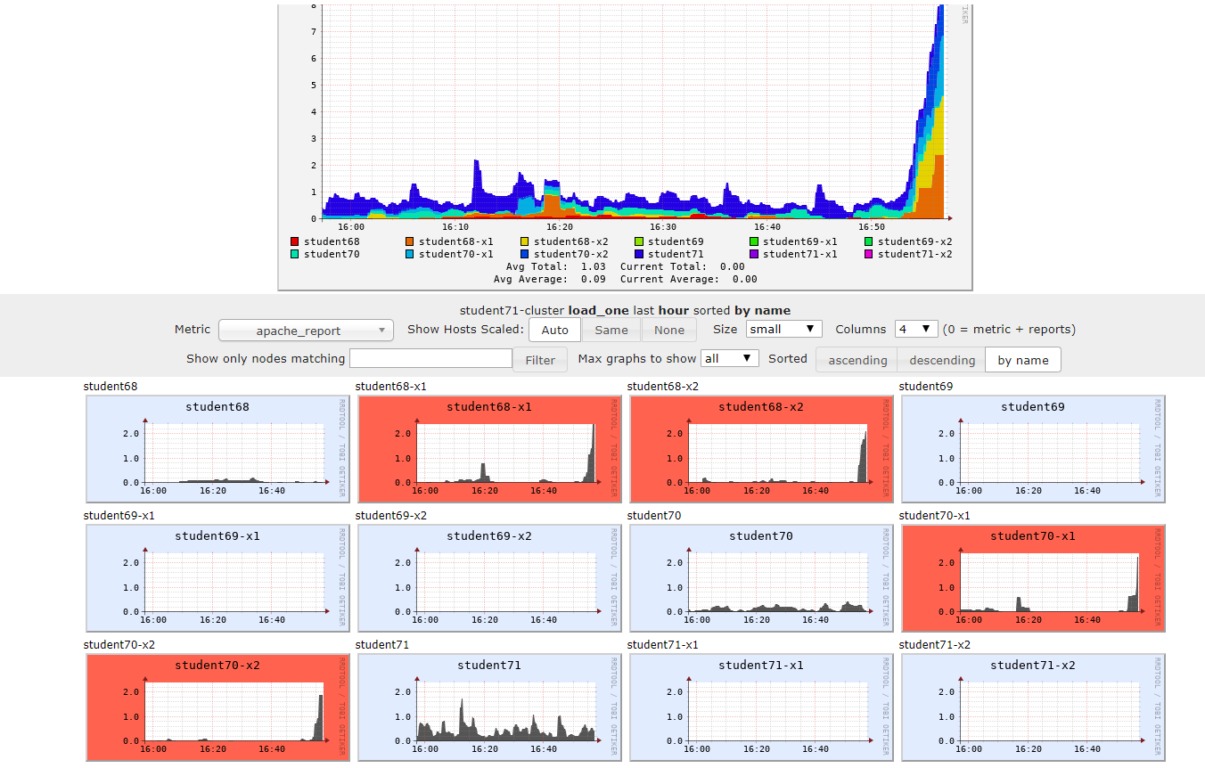
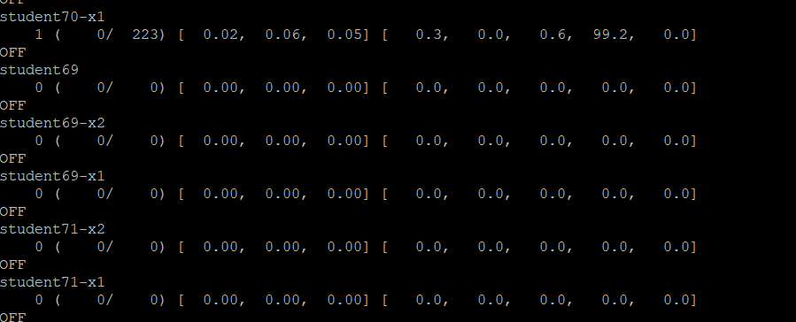
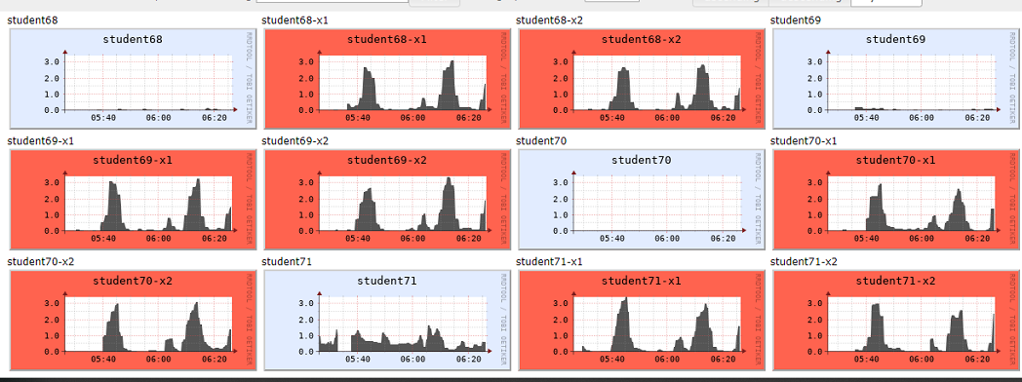
6.2. No monitored information in 4 vms.
69-x1, 69-x2, 71-x1, 71-x2’s information cannot be monitored in our ganglia.
Time: 15 April
Problem Introduction: We have finished our code and run it successfully and get our result, while we find that 69-x1, 69-x2, 71-x1, 71-x2’s information cannot be monitored in our ganglia website and ‘gstat -a’:
Process: 1. check configuration core-site.xml and other Hadoop in all VMs.(All right so it looks no problems in Hadoop).
2. restart ganglia and restart the monitor in this nodes by code:” sudo -S su - -c 'service ganglia-monitor restart’”(Workful!)
Analysis: Some nodes’ monitor are not started or lose efficacy.

Slide 44
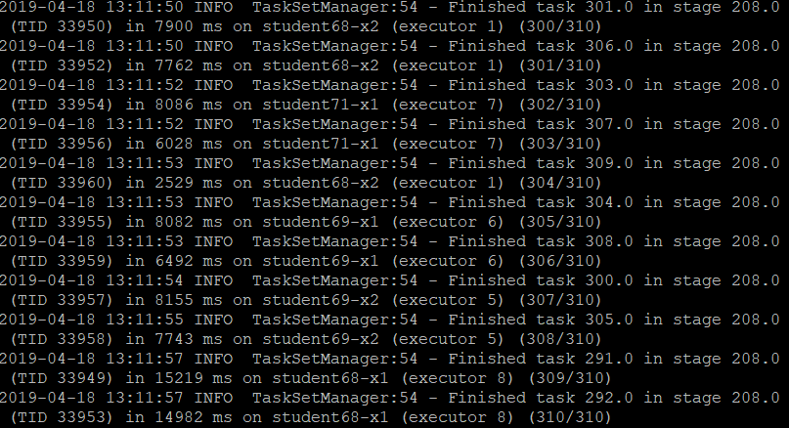
6.3. SVM’s invalid problems
SVM algorithm stopped in some places.
Time: 17 April
Problem Introduction: We want to use SVM to do another experience for sentiment analysis while the process showed some place are wrong here.
Process: Change the data to start from zero.
Analysis: SVM in Spark.Mlib can just recognize status begin with 0, and it will stop here without any errors or warnings.

Slide 45
07
PART
Reference
Tiles and URLS of all the important references.
Notes:
模板来自于 http://meihua.docer.com/

Slide 46
7 Reference
Spark Configuration:
http://spark.apache.org/docs/latest/configuration.html
Spark Mllib:
https://spark.apache.org/mllib/
Yelp Website:
https://www.yelp.com/dataset/documentation/main
Yelp Dataset:
https://www.yelp.com/dataset/download
Open-source code:
https://github.com/zhourunlai/sentiment/blob/master/classifier/sparkmllib.py
https://github.com/haoopeng/CNN-yelp-challenge-2016-sentiment-classification/blob/master/json-csv.py

